Slide 1

COOLING HEATING SYSTEM
sinasalahshour74@gmail.com

Slide 2
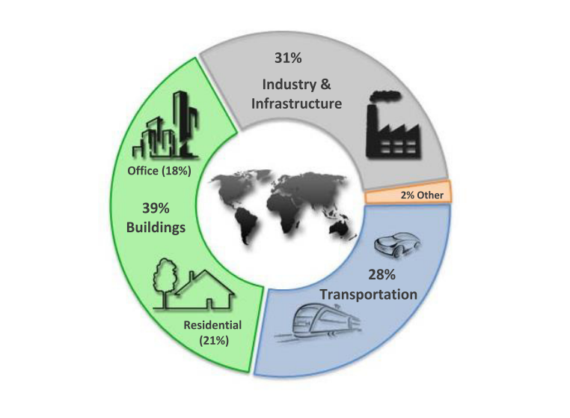
ENERGY CONSUMPTION
2

Slide 3
ENERGY CONSUMPTION OF HOME
3

Slide 4
ENERGY CONSUMPTION OF OFFICE BUILDING
4

Slide 5
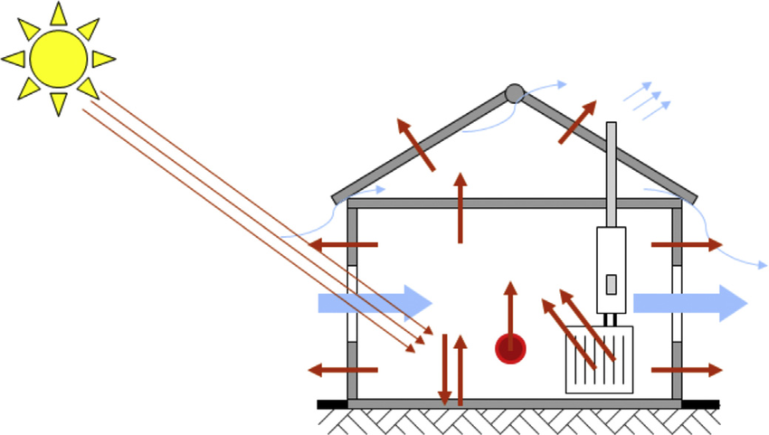
THERMAL MODEL
5

Slide 6
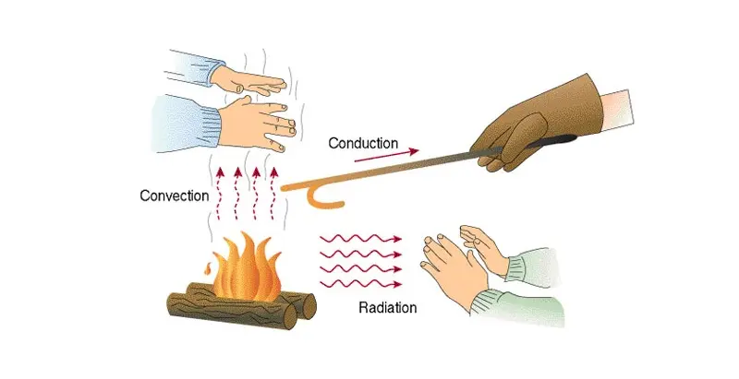
THERMAL MODEL
6

Slide 7
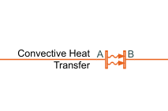
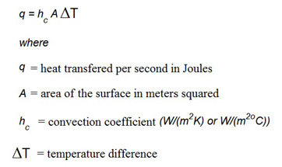
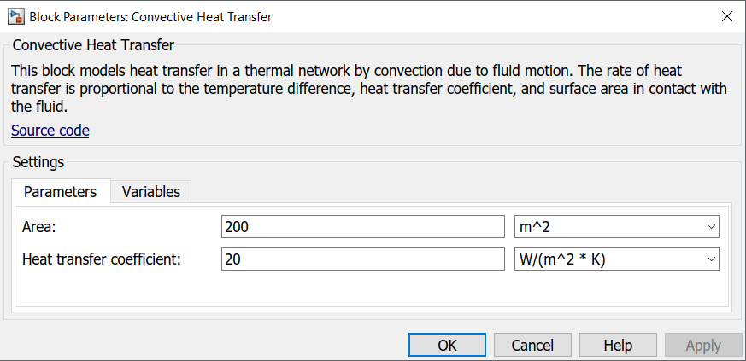
CONVECTION IN SIMSCAPE
7

Slide 8
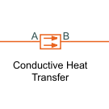
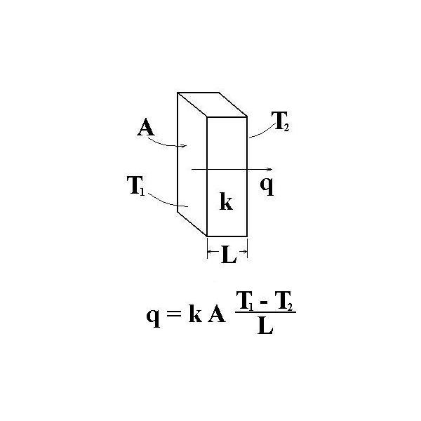
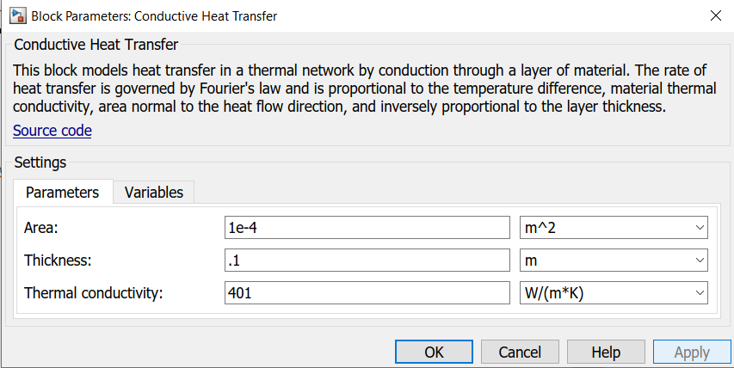
CONDUCTION IN SIMSCAPE
8

Slide 9
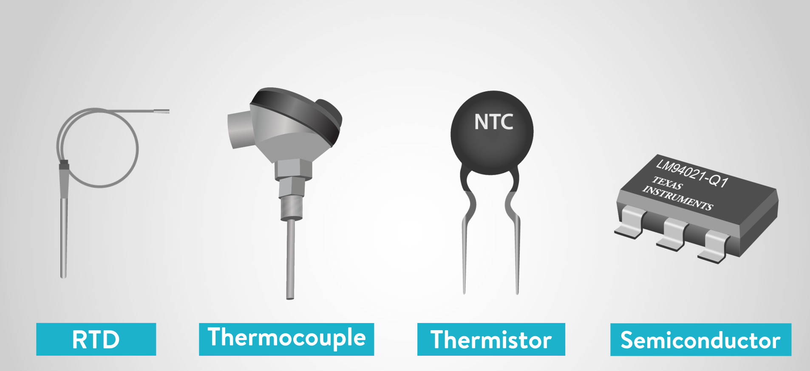
SENSORS
9

Slide 10
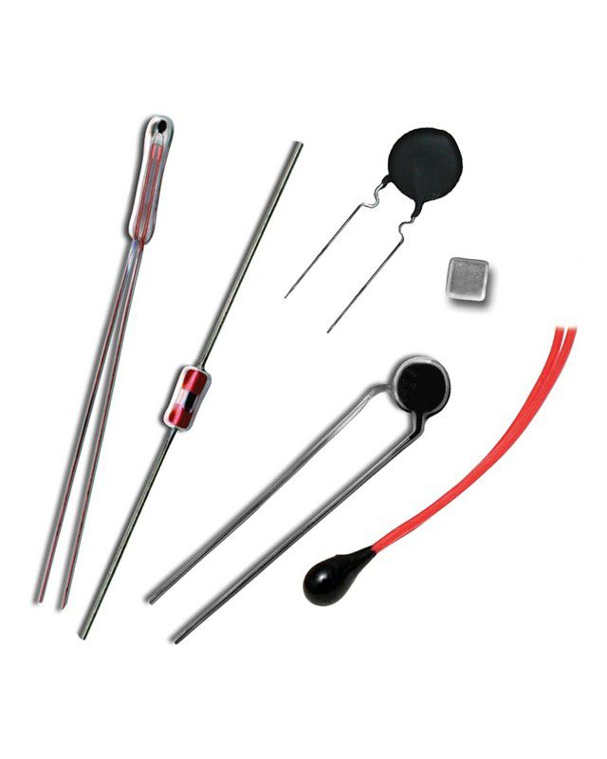
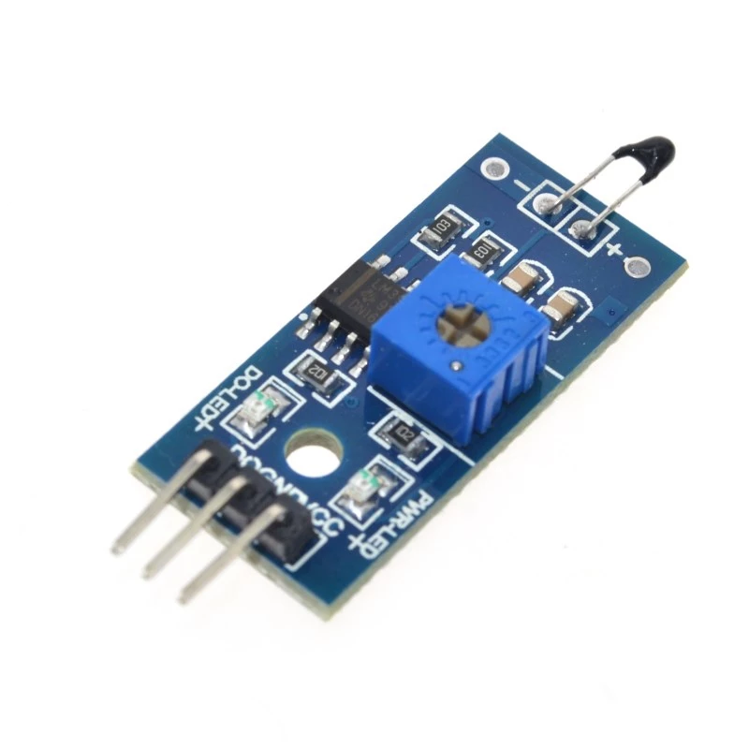
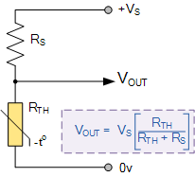
THERMISTOR

Slide 11
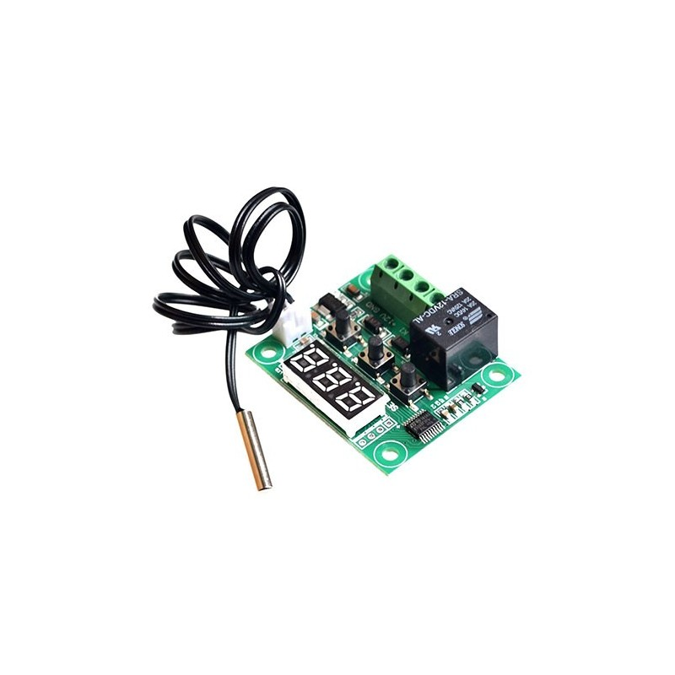
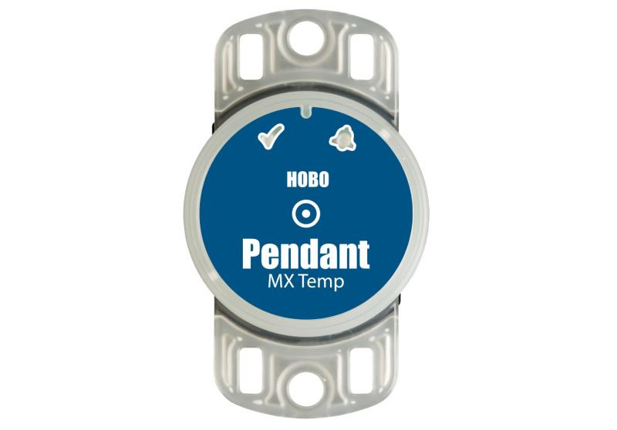
THERMISTOR
11

Slide 12
Performance terminology of sensor
Sensor
Range
Accuracy
Resolution
Drift
12

Slide 13
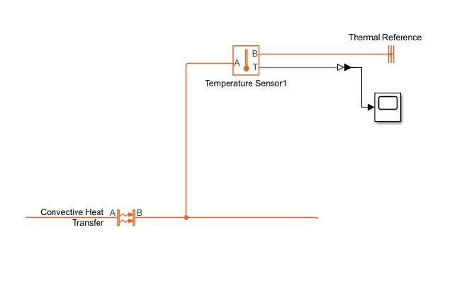
TEMPERATURE SENSOR SIMSCAPE
13

Slide 14


ACTUATOR

Slide 15
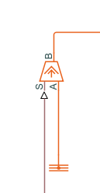

HEATER & COOLER IN SIMSCAPE
15

Slide 16


CONTROL SYSTEM

Slide 17

simulation

Slide 18
sinasalahshour74@gmail.com

